Slide 1


UNIVERSITY OF PADUA
ICT FOR INTERNET AND
MULTIMEDIA
Human data analytics
Improvement of a CNN simple audio recognition system
05/09/2018
Alessio Stefanelli
Giulio Pilotto

Slide 2
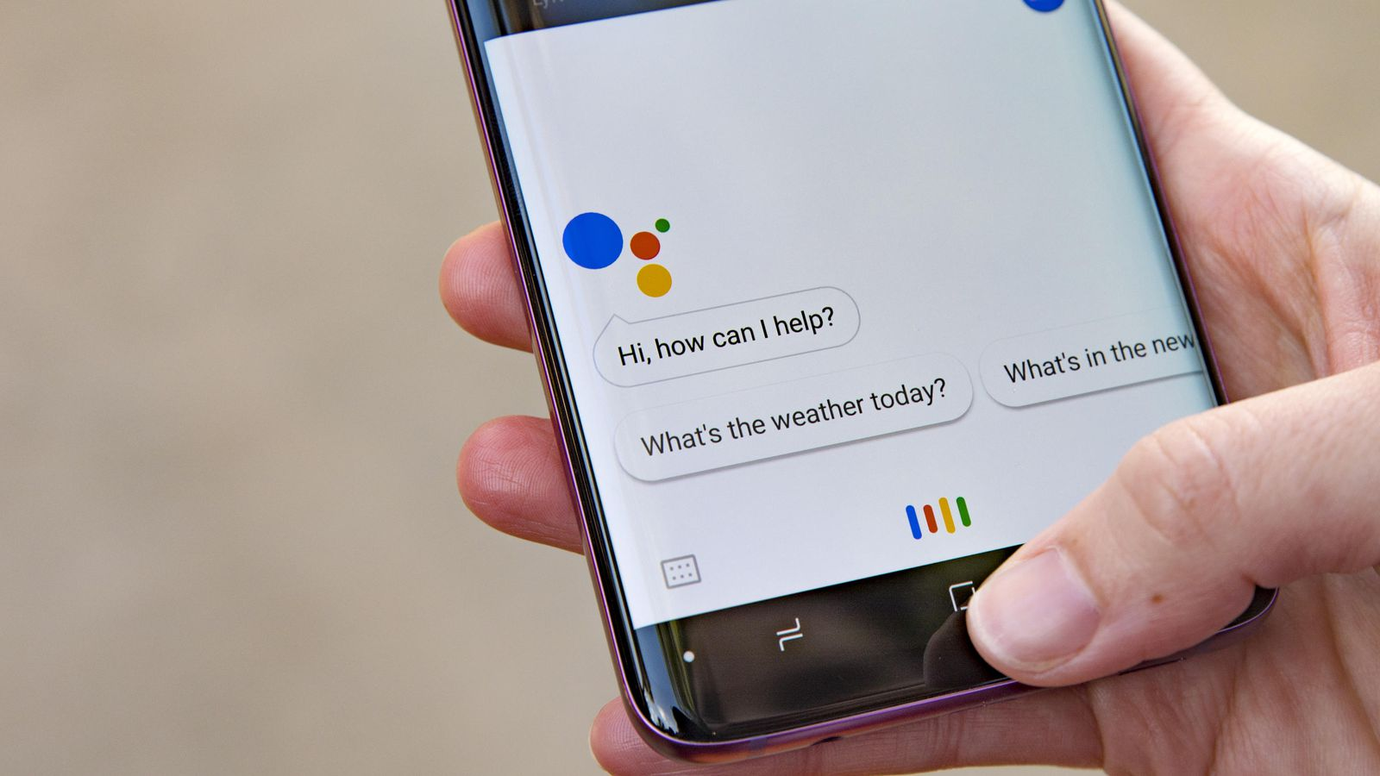
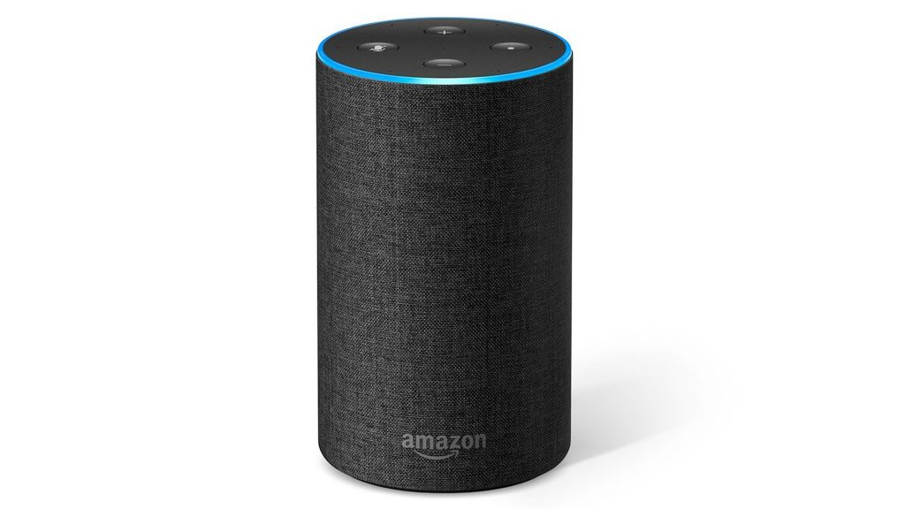

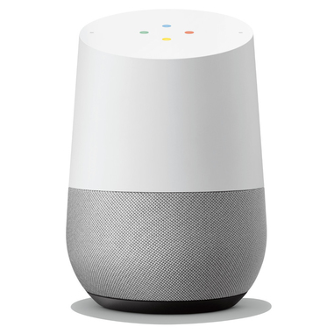
Introduction

Slide 3
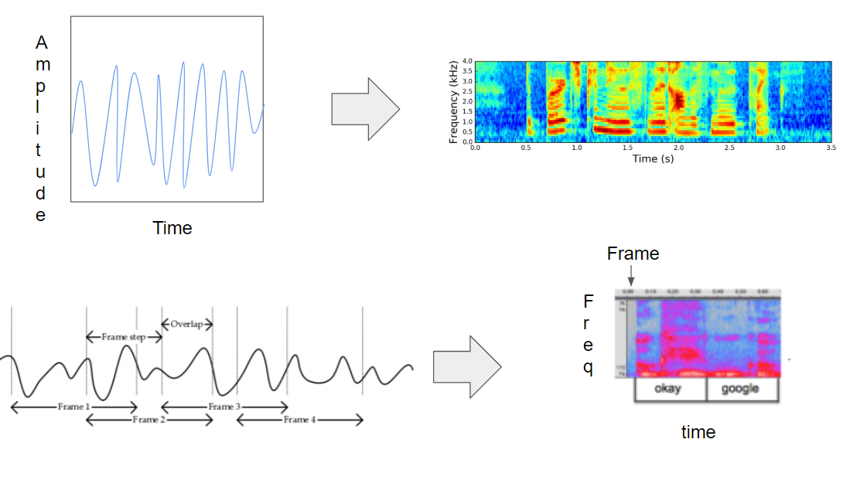
From a audio clip to a power spectrum

Slide 4
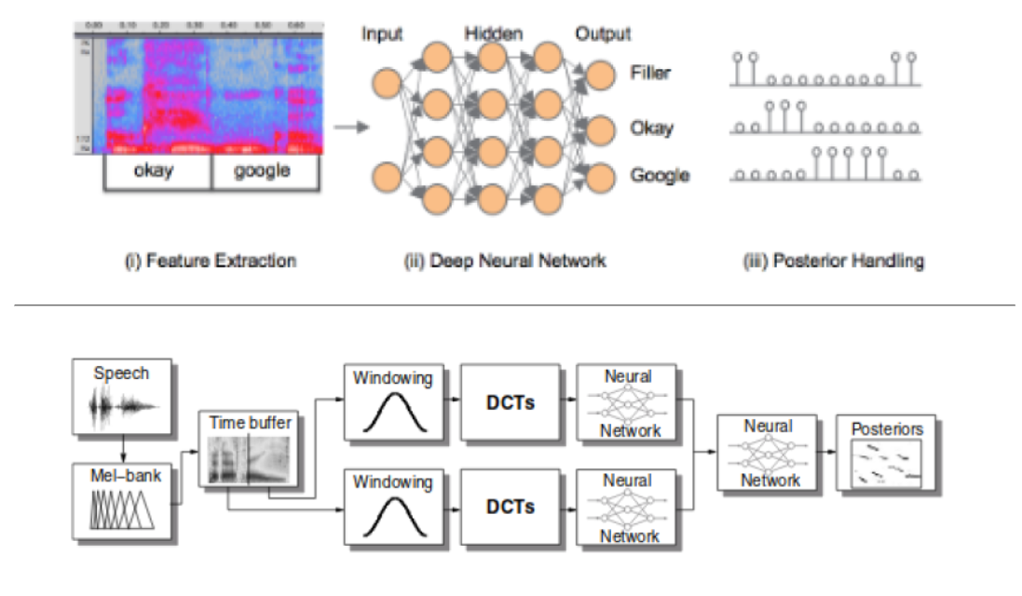
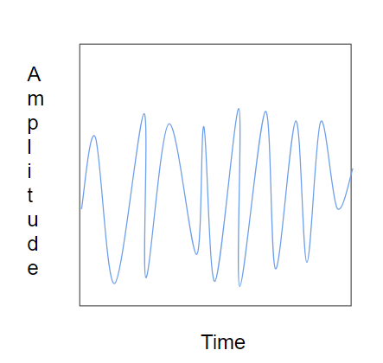
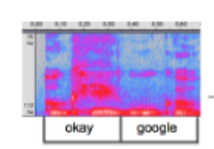
Related Work

Slide 5
Related Work

Slide 6
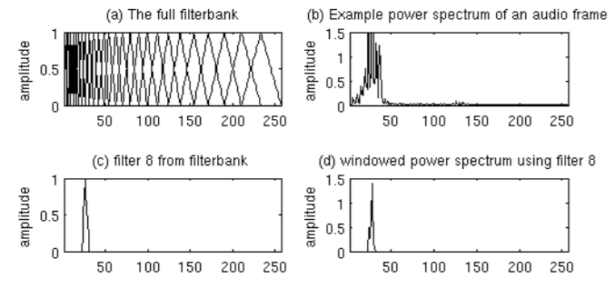
Related Work

Slide 7
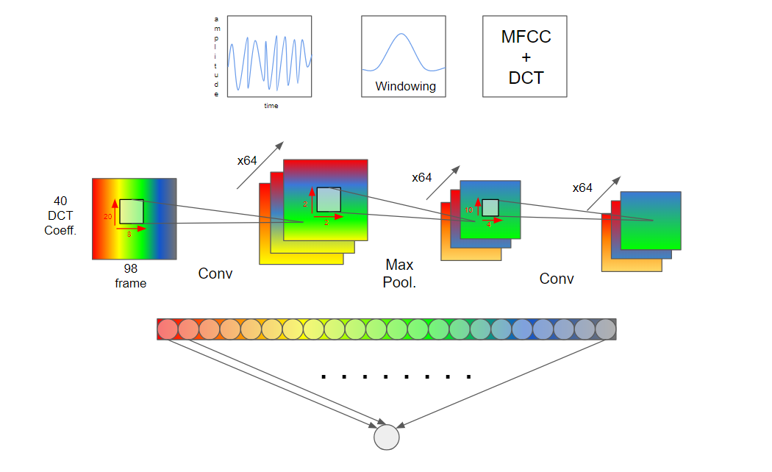
The proposed CNN structure in [1]
[1] T.Sainath and C.Parada,»Convolutional Neural Networks for Small-footprint Keyword Spotting»,
INTERSPEECH 2015, Google,Inc., New York,NY,USA.

Slide 8
Dataset
The dataset consisted of 105,829 utterances of 35 word.
Each utterance is stored as one-second WAVE format files sapled at 16Hz rate.
There are 2618 speaker recorded.
Wanted words: Yes, No , Up, Down, Left, Right, On, Off, Stop, Go.
Unwanted words: Bed, Bird, Cat, Dog , Happy, House, Marvin, Sheila, Tree.
The dataset is divide in training set 80%, test set 10%, validation set 10%

Slide 9
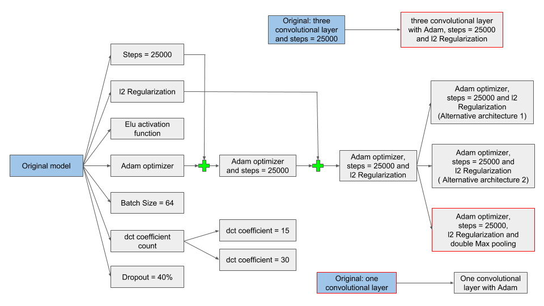
Improvement of the original network

Slide 10
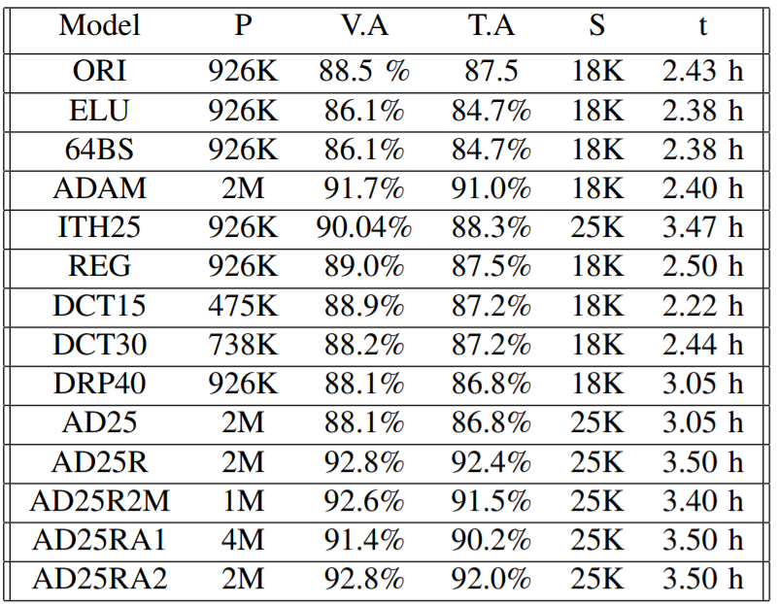
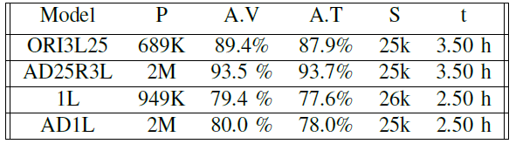
Results

Slide 11
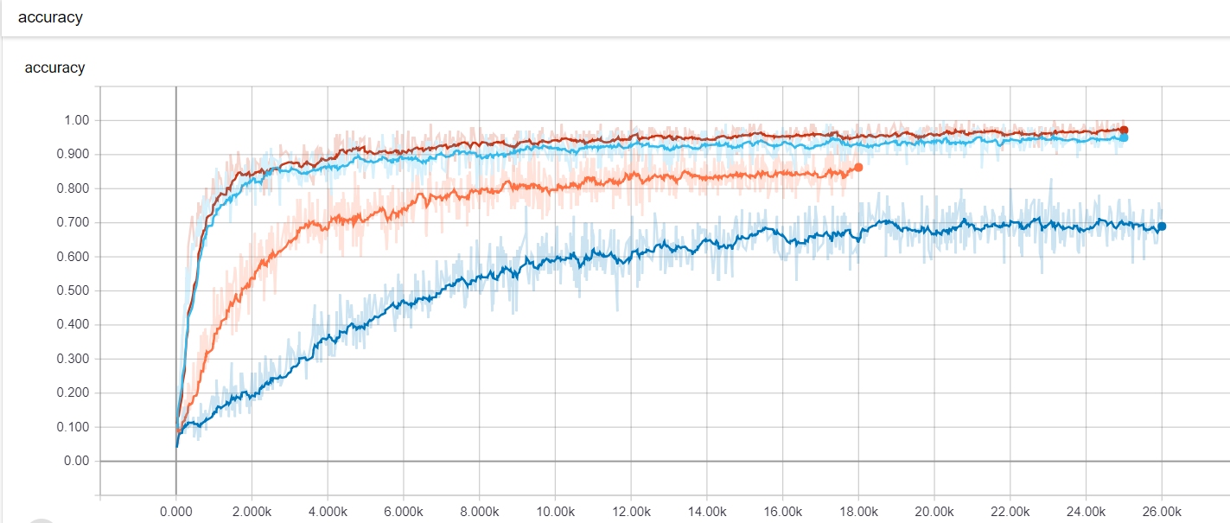
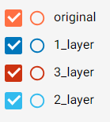
Comparison

Slide 12
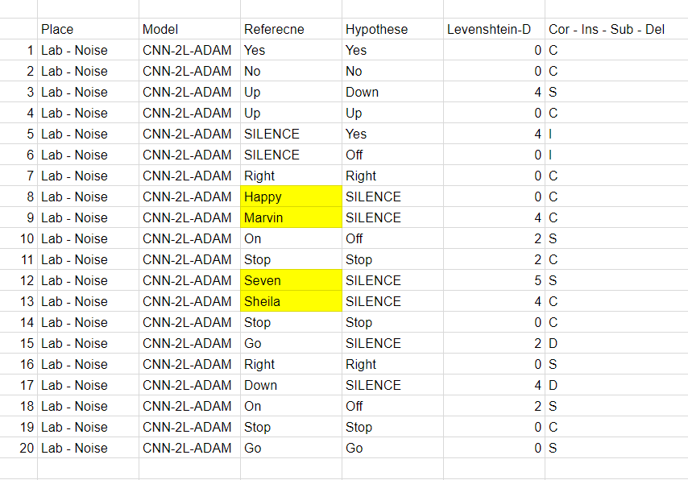
Testing Android Application

Slide 13
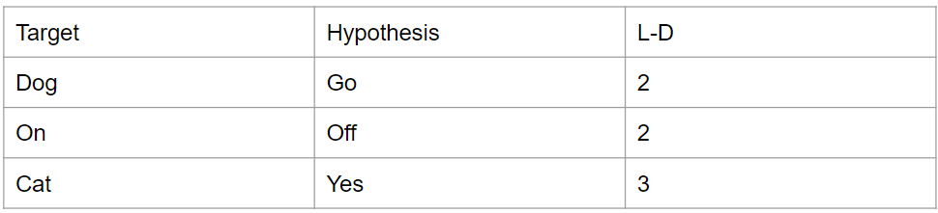
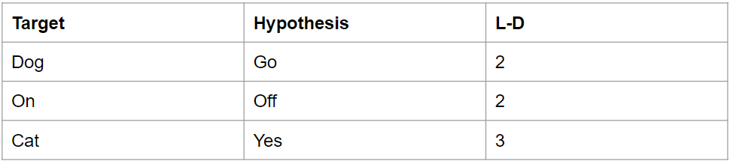
Levenshtein Distance

Slide 14
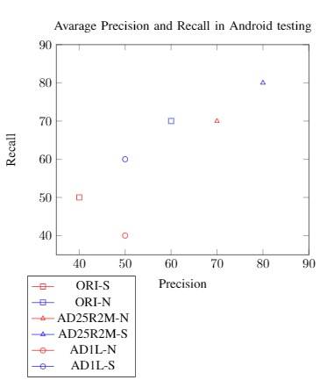
Precision and Recall

Slide 15
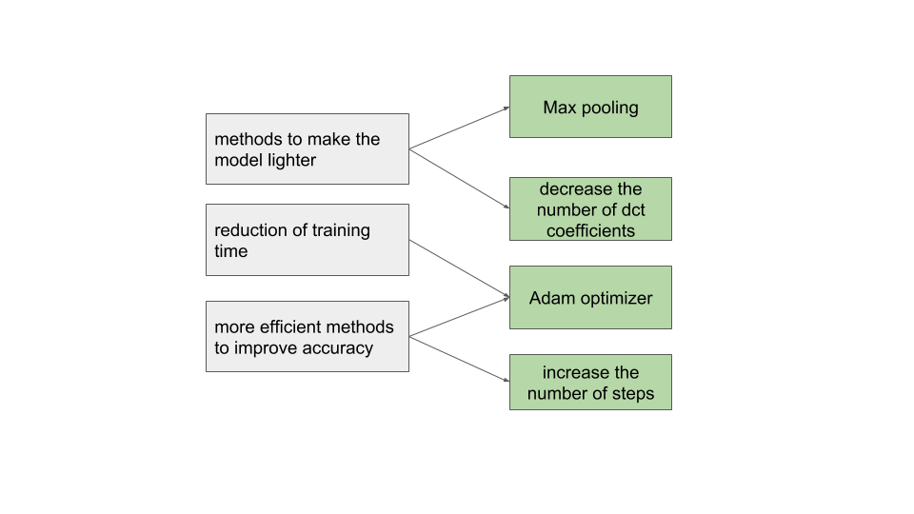
Conclusion
Using this methods we improved the accuracy from 88% to 93%
We have proposed a lighter alternative
We have proposed a lighter alternative
We have proposed a heavier but slightly more performing alternative
Future developement: develop a lighter model that maintains or even increase the accuracy

